Slide 1


Susmitha Babu Vishnu
25/12/2023

Slide 2

Outline
Executive Summary
Introduction
Methodology
Results
Conclusion
Appendix

Slide 3
Executive Summary
Summary of methodologies
Data Collection through API
Data Collection with Web Scraping
Data Wrangling
Exploratory Data Analysis with SQL
Exploratory Data Analysis with Data Visualization
Interactive Visual Analytics with Folium
Machine Learning Prediction
Summary of all results
Exploratory Data Analysis result
Interactive analytics in screenshots
Predictive Analytics result

Slide 4
Introduction
Project background and context
SpaceX is a ground-breaking corporation that has completely changed the space sector by providing rocket launches, notably Falcon 9, for as little as $62 million, compared to other suppliers that charge as much as $165 million for each launch.
The majority of these savings are attributable to SpaceX's brilliant concept to re-land the rocket after the first stage of the launch so that it can be used on a later flight. The price will drop considerably more if this practice is repeated.
We, as data scientists in SpaceY, use this data to compete with SpaceX.
Problems you want to find answers
Factors determining if the rocket will land successfully
Interaction amongst various features that determine the success rate of a successful landing
Operating conditions which needs to be in place to ensure a successful landing program
Github Link of the Main branch with all files and codes:
https://github.com/Susmithavishnu/Applied-Data-Science-Capstone-Project/tree/main

Slide 5

Section 1

Slide 6
Methodology
Executive Summary
Data collection methodology:
Data was collected using SpaceX REST API and web scrapping from Wikipedia
Perform data wrangling
Data was processed using one-hot encoding for categorical features
Perform exploratory data analysis (EDA) using visualization and SQL
Perform interactive visual analytics using Folium and Plotly Dash
Perform predictive analysis using classification models
The collected data were normalized, divided into training and test sets and evaluated by four different classification models with their accuracies.

Slide 7
Data Collection
Data sets were collected from:
Space X API (https://api.spacexdata.com/v4/rockets/) &
Wikipedia (https://en.wikipedia.org/wiki/List_of_Falcon/_9/_and_Falcon_Heavy_launches), using web scraping techniques.
Data has been collected using the below steps -
Collected the data using GET request to the SpaceX API
Decoded the response content as a JSON using .json() function call and converted it into a pandas dataframe using .json_normalize()
Data cleaning was done. Checked for missing values and filled them wherever necessary
Web scraping from Wikipedia for Falcon 9 launch records with BeautifulSoup

Slide 8
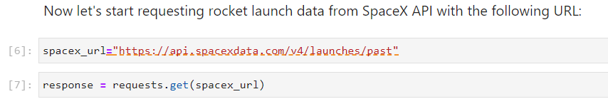
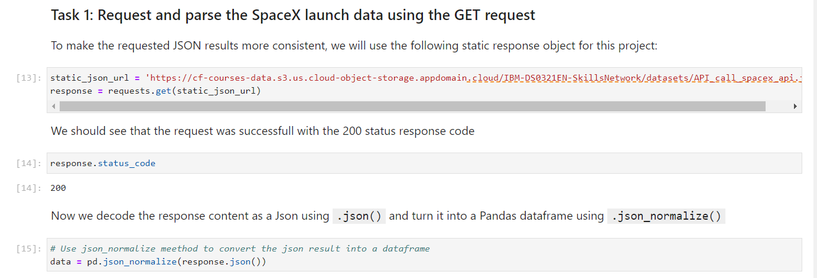
Data Collection – SpaceX API
GET request for launch data using API
Convert to a dataframe
Perform Data Cleaning
Place your flowchart of SpaceX API calls here
Github Link: https://github.com/Susmithavishnu/Applied-Data-Science-Capstone-Project/blob/main/jupyter-labs-spacex-data-collection-api.ipynb

Slide 9
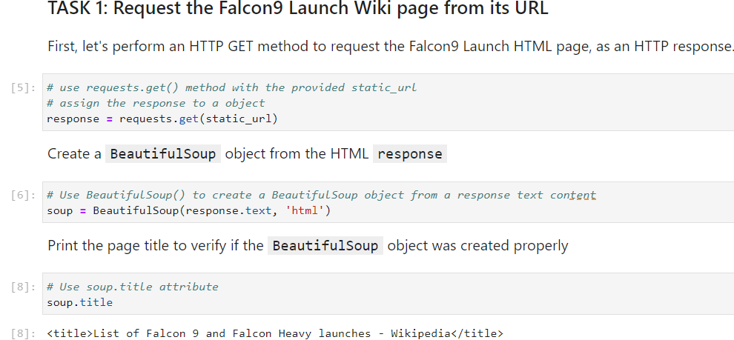
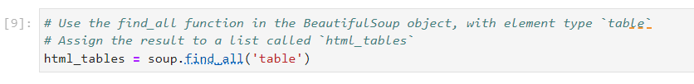
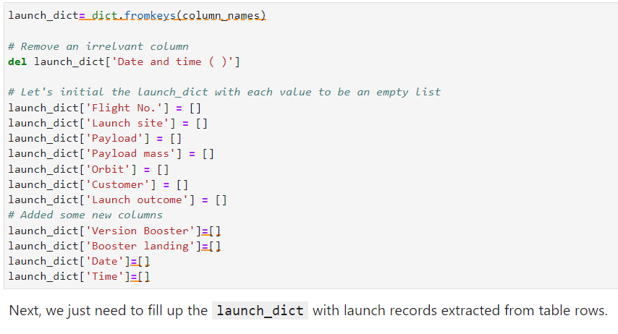
Data Collection - Scraping
Request Falcon9 launch data from Wiki page
Create BeautifulSoup from HTML response
Extract all column names from HTML header
Place your flowchart of web scraping here
Github Link: https://github.com/Susmithavishnu/Applied-Data-Science-Capstone-Project/blob/main/jupyter-labs-webscraping.ipynb

Slide 10
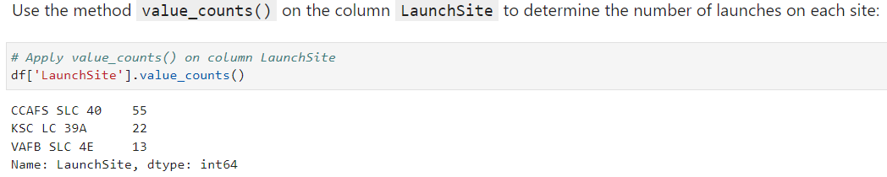
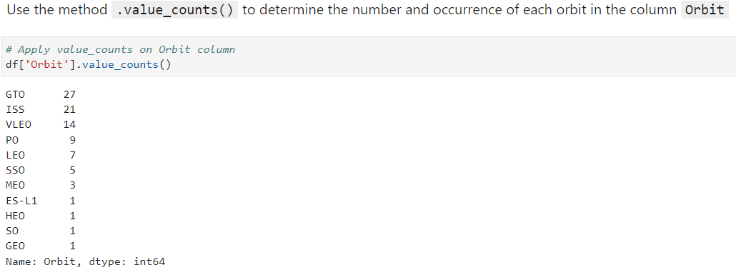
Data Wrangling
Data Wrangling is the process of cleaning and unifying messy and complex data sets for easy access and Exploratory Data Analysis (EDA).
We will first calculate the number of launches on each site, then calculate the number and occurrence of mission outcome per orbit type.
We then create a landing outcome label from the outcome column. This will make it easier for further analysis, visualization, and ML. Lastly, we will export the result to a CSV
Github Link: https://github.com/Susmithavishnu/Applied-Data-Science-Capstone-Project/blob/main/labs-jupyter-spacex-Data%20wrangling.ipynb

Slide 11
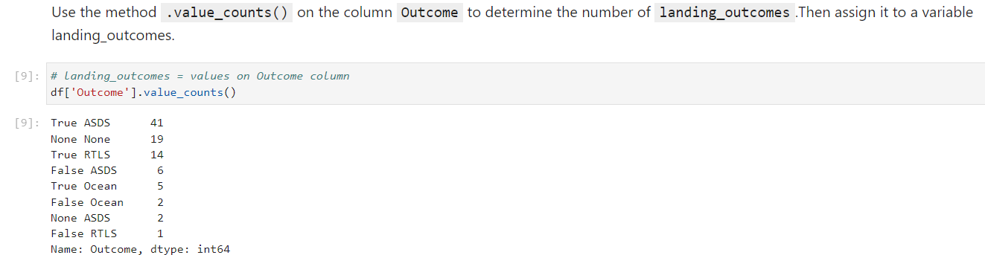
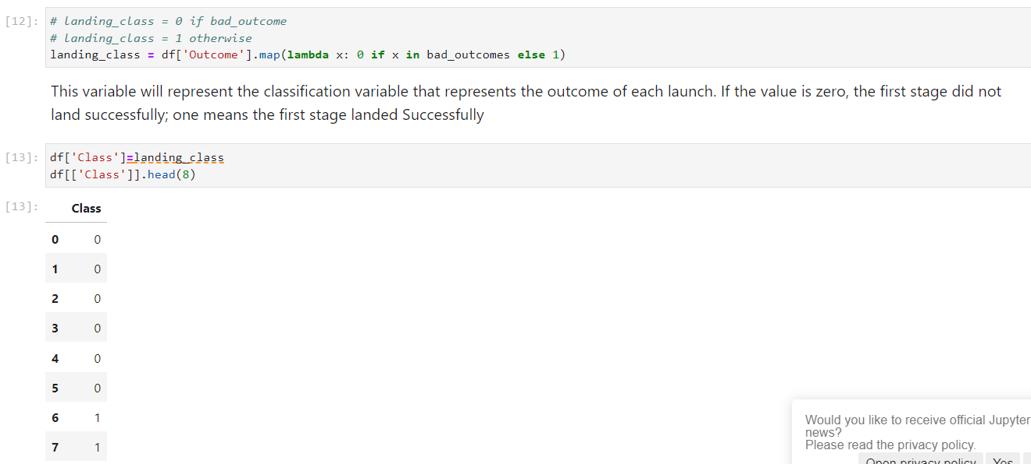
Data Wrangling

Slide 12
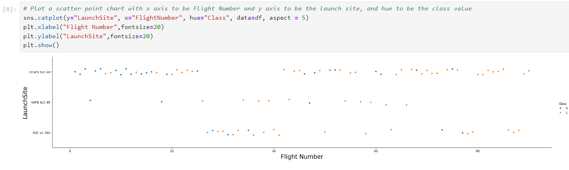
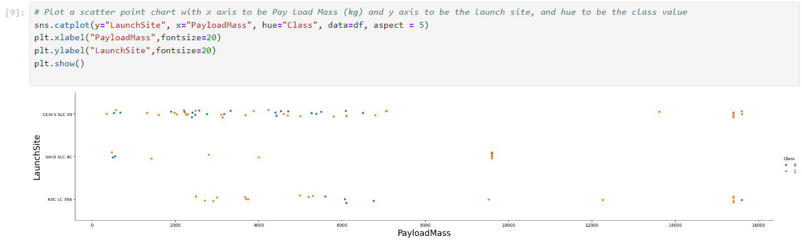
EDA with Data Visualization
Flight Number x Launch Site
scatter graph
Payload Mass x Launch Site scatter graph

Slide 13
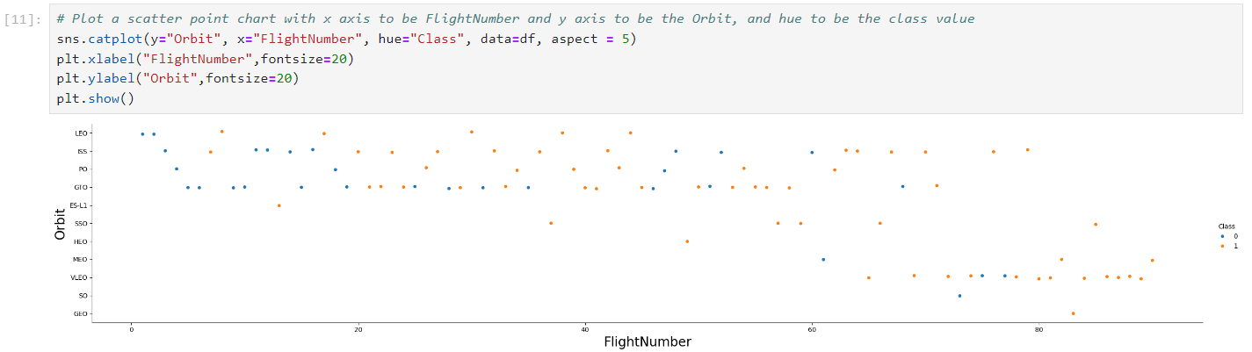
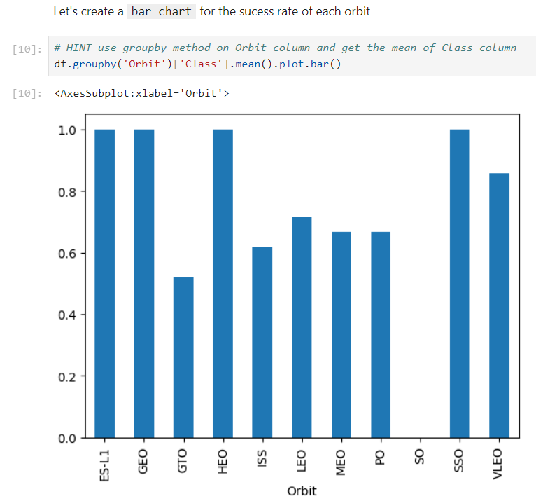
EDA with Data Visualization
Flight number x Orbit Scatter plot
Bar Chart showing success rate of each orbit

Slide 14
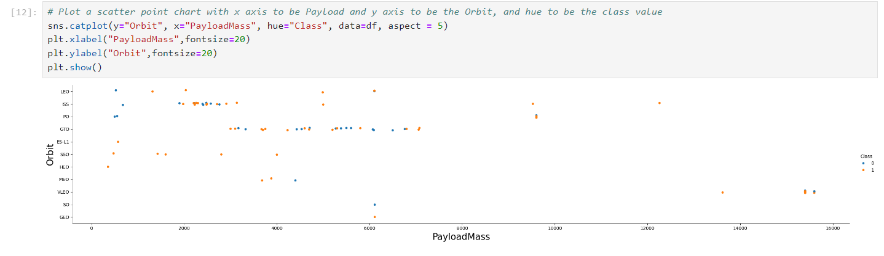
EDA with Data Visualization
Flight Number x Orbit scatter plot
Payload Mass x Orbit scatter plot

Slide 15
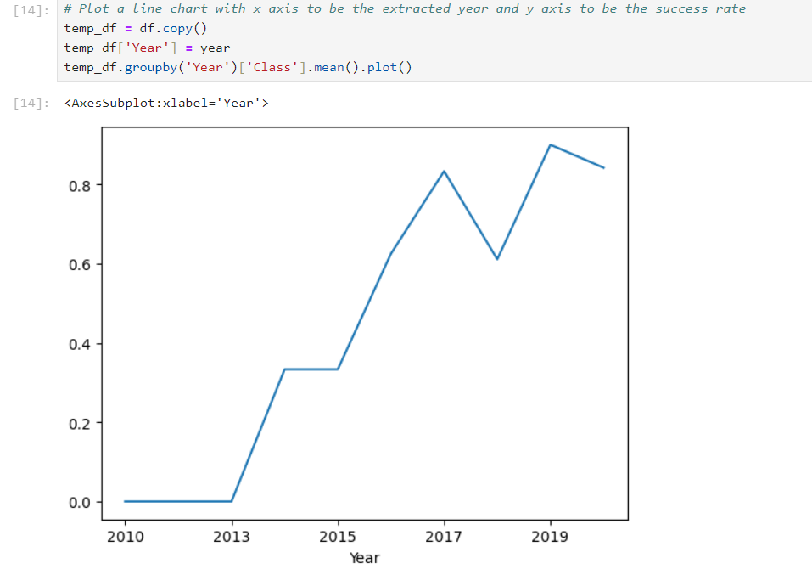
EDA with Data Visualization
Line chart which plots the year against the success rate
Github Link for all the Data Viz. graphs: https://github.com/Susmithavishnu/Applied-Data-Science-Capstone-Project/blob/main/jupyter-labs-eda-dataviz.ipynb.jupyterlite.ipynb

Slide 16
EDA with SQL
EDA was done with SQL queries for the following prompts
Displaying the names of the launch sites.
Displaying 5 records where launch sites begin with the string ‘CCA’.
Displaying the total payload mass carried by booster launched by NASA (CRS).
Displaying the average payload mass carried by booster version F9 v1.1.
Listing the date when the first successful landing outcome in ground pad was achieved.
Listing the names of the boosters which have success in drone ship and have payload mass greater than 4000 but less than 6000.
Listing the total number of successful and failure mission outcomes.
Listing the names of the booster versions which have carried the maximum payload mass.
Listing the failed landing outcomes in drone ship, their booster versions, and launch sites names for in year 2015
Rank the count of landing outcomes or success between the date 2010-06-04 and 2017-03-20, in descending order.
Github Link: https://github.com/Susmithavishnu/Applied-Data-Science-Capstone-Project/blob/main/jupyter-labs-eda-sql-coursera_sqllite.ipynb

Slide 17
Build an Interactive Map with Folium
To visualize the launch data into an interactive map. We took the latitude and longitude coordinates at each launch site and added a circle marker around each launch site with a label of the name of the launch site.
We then assigned the dataframe launch_outcomes(failure,success) to classes 0 and 1 with Red and Green markers on the map in MarkerCluster().
We then used the Haversine’s formula to calculated the distance of the launch sites to various landmark to find answer to the questions of:
How close the launch sites with railways, highways and coastlines?
How close the launch sites with nearby cities?
Github Link: https://github.com/Susmithavishnu/Applied-Data-Science-Capstone-Project/blob/main/lab_jupyter_launch_site_location.jupyterlite.ipynb

Slide 18
Build a Dashboard with Plotly Dash
We built an interactive dashboard with Plotly dash which allowing the user to play around with the data as they need.
We plotted pie charts showing the total launches by a certain sites.
We then plotted scatter graph showing the relationship with Outcome and Payload
Mass (Kg) for the different booster version.
Github Link: https://github.com/Susmithavishnu/Applied-Data-Science-Capstone-Project/blob/main/spacex_dash_app.py

Slide 19
Predictive Analysis (Classification)
Building the Model
•Transform the data and
then split into training and
test datasets
•Decide which type of ML algorithms to use
•Set the parameters and
algorithms to GridSearchCV
and fit it to dataset.
Evaluating the Model
•Check the accuracy for each model
•Get tuned hyperparameters
for each type of algorithms.
•plot the confusion matrix
Improving the Model
•Use Feature Engineering
and Algorithm Tuning
Find the Best Model
Github Link: https://github.com/Susmithavishnu/Applied-Data-Science-Capstone-Project/blob/main/SpaceX_Machine_Learning_Prediction_Part_5.jupyterlite.ipynb

Slide 20
Results
Exploratory data analysis results
Interactive analytics demo in screenshots
Predictive analysis results

Slide 21

Section 2

Slide 22
Flight Number vs. Launch Site
Larger the flights amount of the launch site, the greater the the success rate will be.
CCAFS SLC40 shows the least pattern of this. i.e, lesser success rate

Slide 23
Payload vs. Launch Site
Once the pay load mass is greater than 7000kg, the probability of the success rate will be highly increased.
But there is no significant pattern to compare these

Slide 24
Success Rate vs. Orbit Type
Shows the success rate for each orbit type.
We can see that SO is the worst/empty and 100% for SSO, HEO, GEO and ES-L1
But, SSO, HEO, GEO and ES-L1 have only one occurrence each

Slide 25
Flight Number vs. Orbit Type
We can see that the larger the flight number on each orbits, the greater the success rate except for GTO orbit which depicts no relationship between both attributes.
We have seen that some orbits only have 1 occurrence so these cannot be seen as good comparisons

Slide 26
Payload vs. Orbit Type
We can see that heavier payload has positive impact on LEO, ISS and P0 orbit.
However, it has negative impact on MEO and VLEO orbit

Slide 27
Launch Success Yearly Trend
We can see an increasing trend from the year 2013 until 2020.
If this trend possibly continues for the next year onward, the success rate may steadily increase to 100%

Slide 28
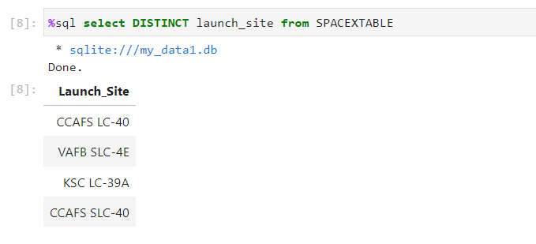
All Launch Site Names
Displays the names of the unique launch sites in the space mission

Slide 29
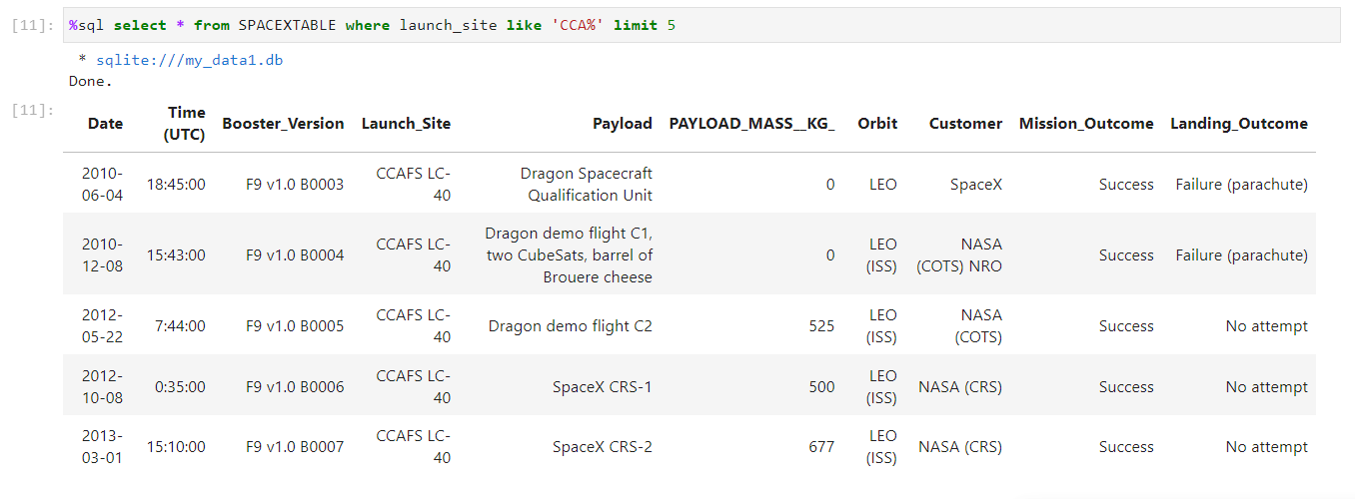
Launch Site Names Begin with 'CCA'
Display 5 records where launch sites begin with the string 'CCA’

Slide 30
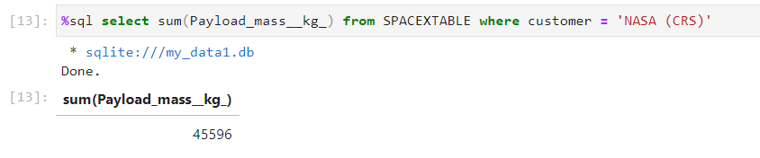
Total Payload Mass
Display the total payload mass carried by boosters launched by NASA (CRS)

Slide 31
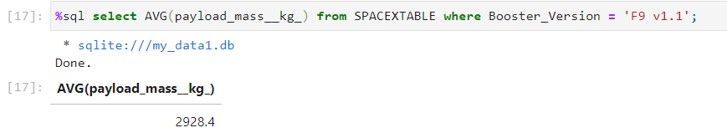
Average Payload Mass by F9 v1.1
Display average payload mass carried by booster version F9 v1.1

Slide 32
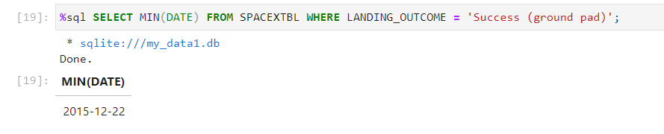
First Successful Ground Landing Date
List the date when the first succesful landing outcome in ground pad was acheived

Slide 33
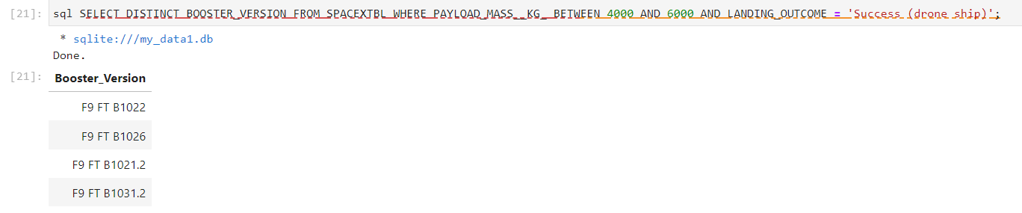
Successful Drone Ship Landing with Payload between 4000 and 6000
List the names of the boosters which have success in drone ship and have payload mass greater than 4000 but less than 6000

Slide 34
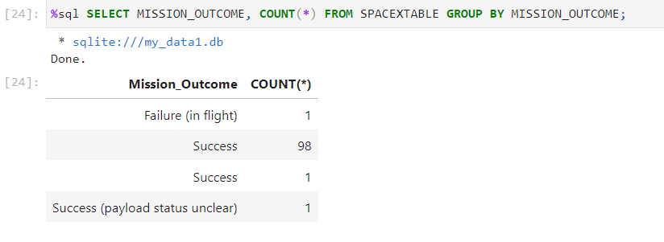
Total Number of Successful and Failure Mission Outcomes
List the total number of successful and failure mission outcomes

Slide 35
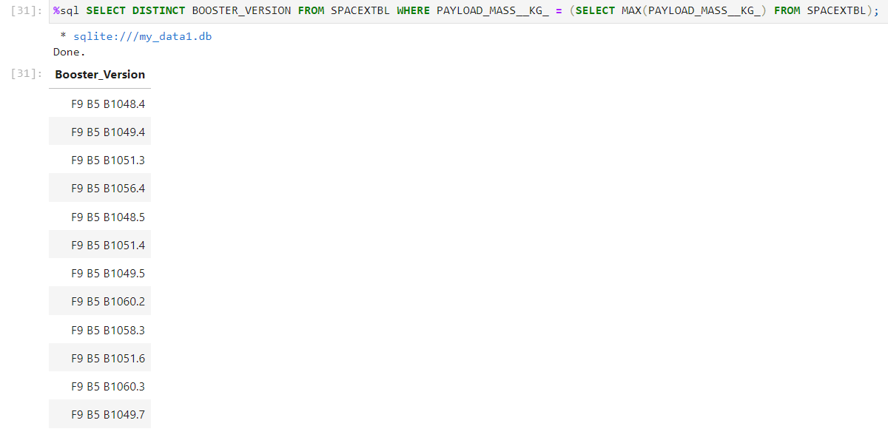
Boosters Carried Maximum Payload
List the names of the booster_versions which have carried the maximum payload mass

Slide 36
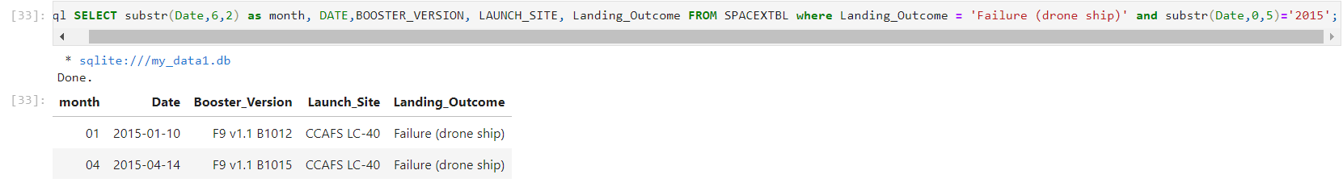
2015 Launch Records
List the records which will display the month names, failure landing_outcomes in drone ship ,booster versions, launch_site for the months in year 2015

Slide 37
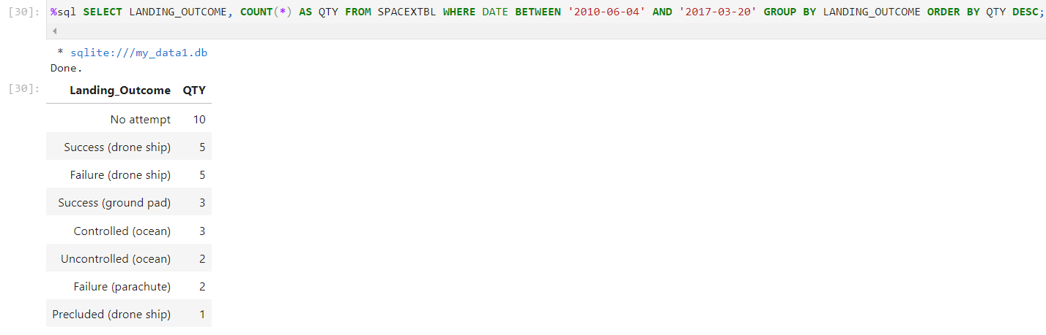
Rank Landing Outcomes Between 2010-06-04 and 2017-03-20
Rank the count of landing outcomes (such as Failure (drone ship) or Success (ground pad)) between the date 2010-06-04 and 2017-03-20, in descending order.

Slide 38

Section 3

Slide 39
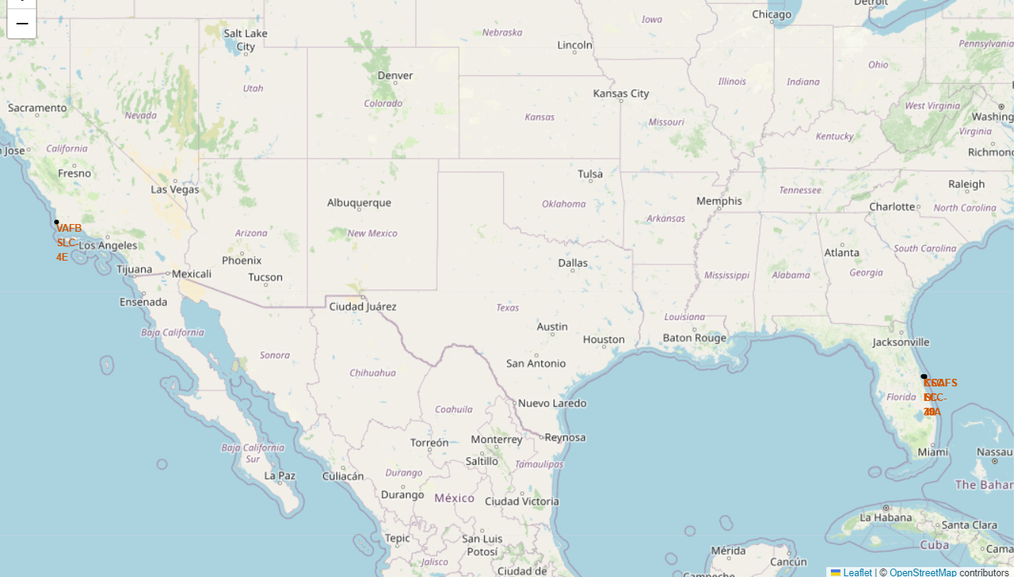
Launch Site Locations
We can see all the SpaceX launch sites are located inside the United States

Slide 40
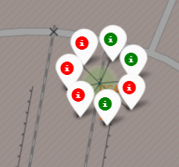
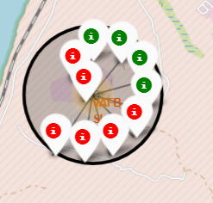
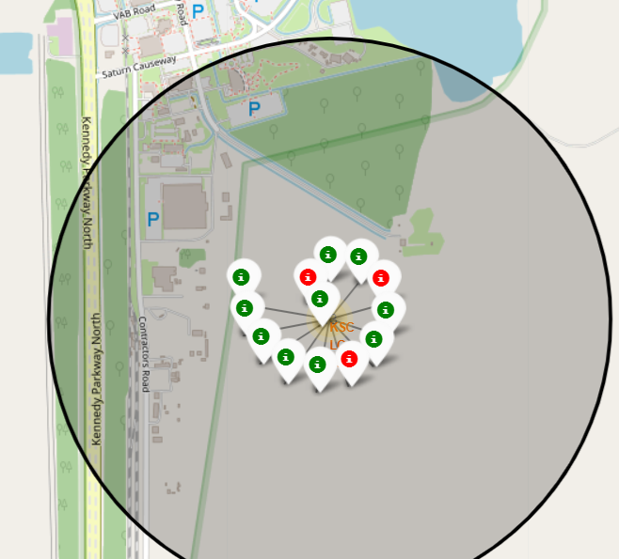
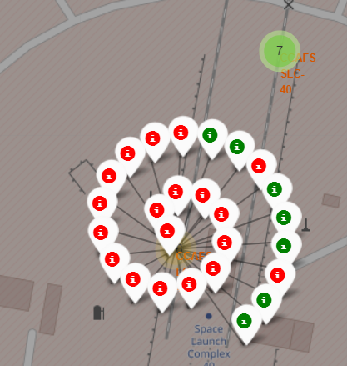
Markers with colored labelled launch sites

Slide 41
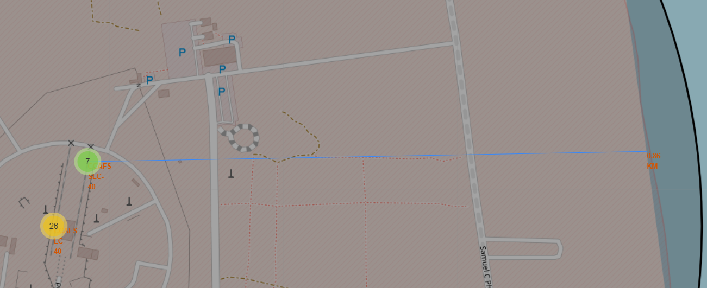
Launch sites distance from Landmarks

Slide 42

Section 4

Slide 43
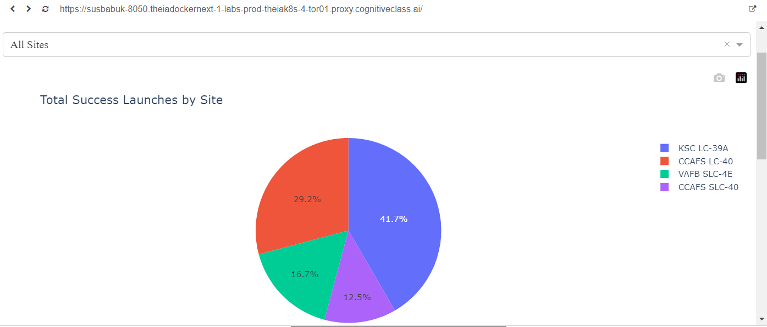
All Sites Success Rates

Slide 44
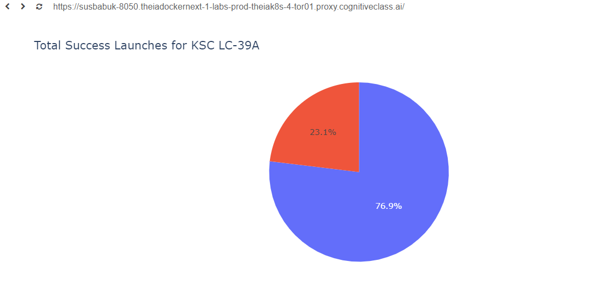
Highest Success Rate

Slide 45
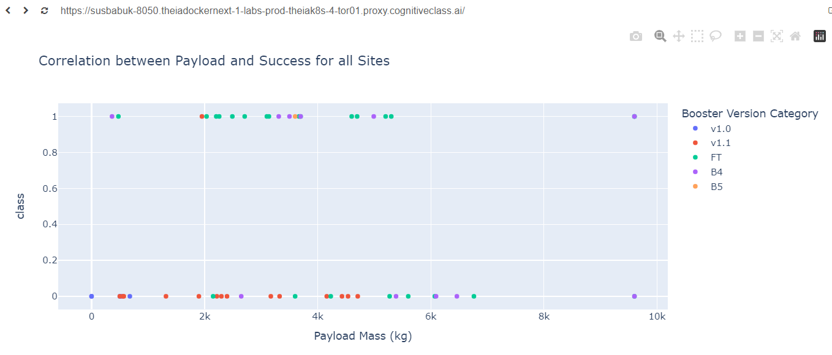
Payload vs Launch Outcome Scatter plot

Slide 46

Section 5

Slide 47
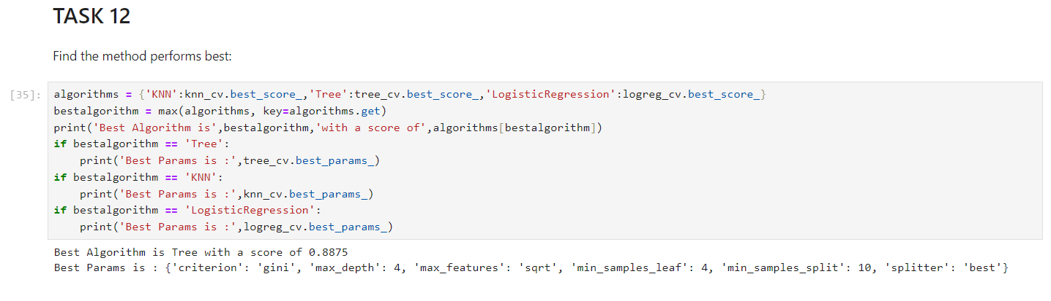
Classification Accuracy
Decision Tree was shown to have the highest classification accuracy with 88.75% score

Slide 48
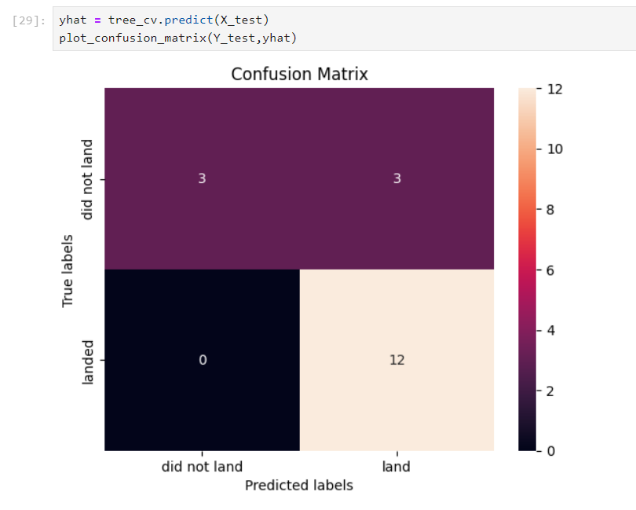
Confusion Matrix
We see 12 True Positive and 3 True Negatives classified which is good. But the 3 False Positives is a problem. Therefore 15/18 were classified accurately
The confusion matrix given can be divided as
Top left – True Negative
Top right – False Positive
Bottom left – False Negative
Bottom right – True Positive

Slide 49
Conclusions
The low weighted payloads, i.e., <4000, performed better than the heavy weighted payloads.
Starting from the year 2013, the success rate for SpaceX launches has increased, directly proportional time in years to 2020, which it will eventually perfect the launches in the future.
KSC LC-39A have the most successful launches of any sites; 76.9%
SSO orbit had a 100% success rate and had more than one occurrence as compared to the others.
The Decision Tree Algorithm is the best Machine Learning approach for this dataset.

Slide 50


